Slide 1
Shark Incident Analysis (1950-2022)
Patterns in Fatalities, Activities, and Environmental Factors
By: Brayden Pearson

Slide 2
Project Overview
•Purpose: Analyze shark incident patterns to identify trends and high-risk factors.
•Research Questions:
•1. Which activities are most common in fatal shark incidents?
•2. Which counties have the highest number of shark incidents?
•3. Do shark incidents show seasonal patterns across the year?

Slide 3
Question 1
Which activities are most common in fatal shark incidents?

Slide 4
Fatal Shark Incidents by Activity
Swimming and surfing/boarding have the highest number of fatal shark incidents, with 5 fatalities each.
Freediving accounts for a smaller number of fatal incidents (3 cases).
Hookah diving and kayaking/canoeing appear rarely, with only 1 fatal incident each.
Overall, most fatal incidents occur during surface-level activities, which aligns with where sharks most frequently encounter humans.
These counts reflect recorded incidents, not risk levels, since participation rates for each activity are unknown.

Slide 5
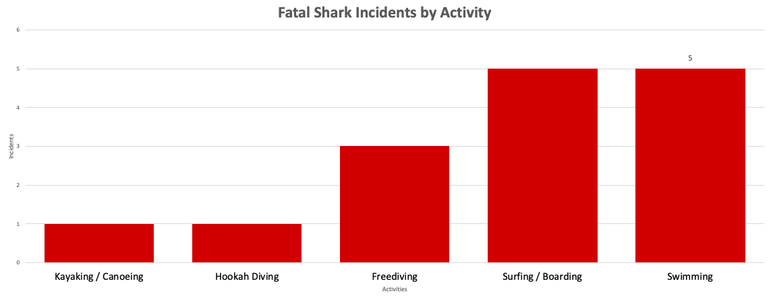

Slide 6
Question 2
Which counties have the highest number of shark incidents?
How do injury severities differ across the counties with the highest number of shark incidents?

Slide 7
Top Counties for Shark Incidents
The stacked column chart shows how shark injury severity varies across the counties with the highest number of incidents. In most counties, minor and major injuries make up the majority of cases, while fatal injuries occur much less frequently. The chart also suggests that some counties have a larger share of major or fatal incidents compared to others, indicating that certain locations may be associated with more severe shark encounters.

Slide 8
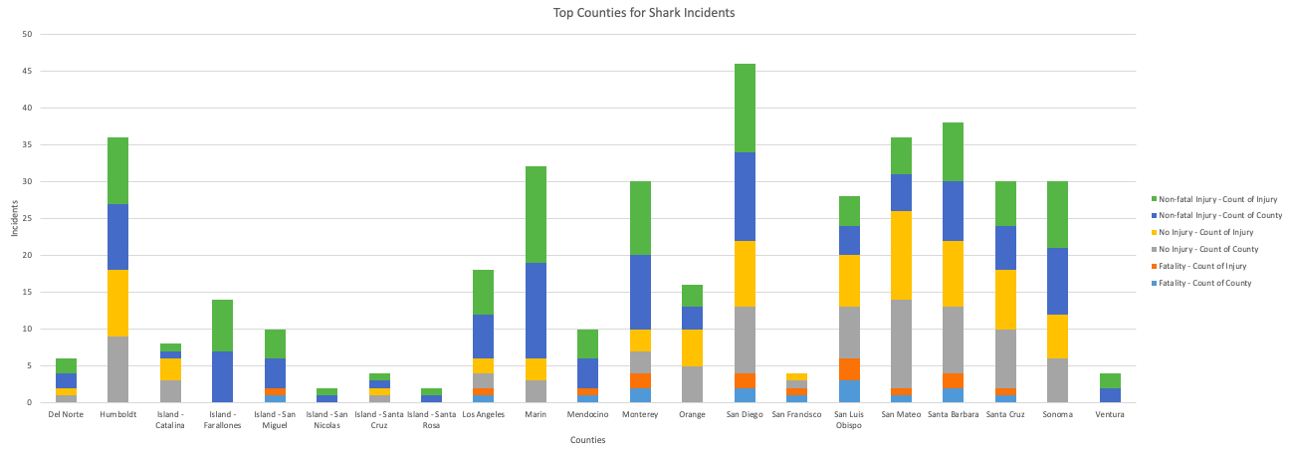

Slide 9
Question 3
Do shark incidents show seasonal patterns across the year?

Slide 10
Seasonal Trends
Shark incidents clearly follow a seasonal pattern. The numbers stay low from January through early spring, then start climbing in May and June. The biggest jump happens in the summer and early fall, with July, August, September, and especially October showing the highest incident counts. After October, the numbers drop again heading into winter. This pattern makes sense because more people are in the water during warmer months, and shark activity also tends to increase during this time.

Slide 11
